Slide 1

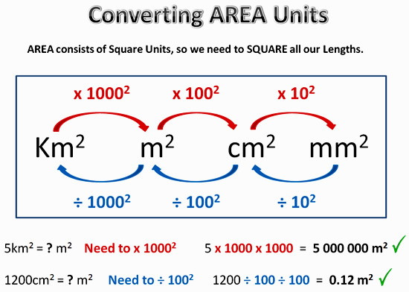
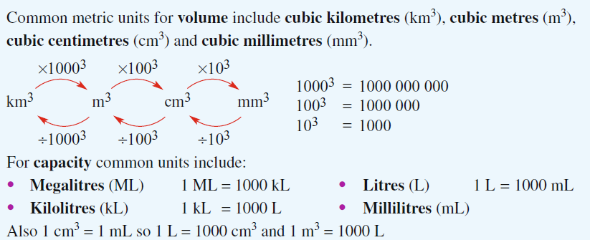
My Measurement Interactive Notebook
Name
Class
Teacher
Term
1

Slide 2
Contents
Glossary or Formula Page
Page
Date
Description
2
3

Slide 3
Tasks
24
7
30
Essential Question
Questions
Notes
Summary
6
7

Slide 4
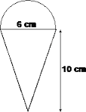
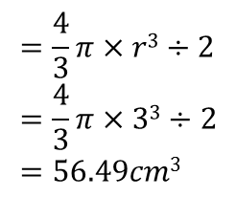
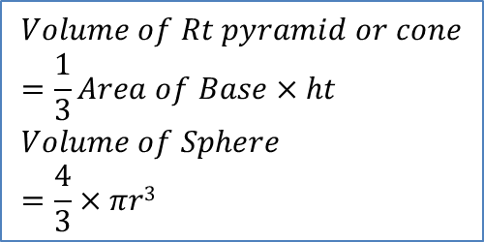
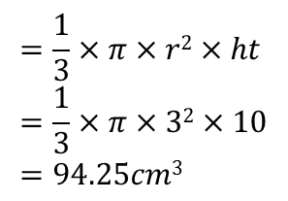
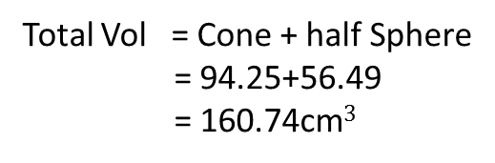
24
7
30
Date
Total Surface Area and Volume Composite Shapes
EQ – Describe how to find the Total Surface Area & Volume of different composite shapes.
How do we find the volume and TSA of 3 dimensional shapes? This time for a cone or pyramid and a sphere.
Find the Volume of this shape and again we need to paint it so you will also need to find the total surface area as well?
Volume – find the volume of the cone.
Vol of cone
$$=\frac{1}{3}×π×r2×ht \\ =\frac{1}{3}×π×32×10 \\ =94.25cm3$$
$$Volume of Rt pyramid or cone \\ =\frac{1}{3}Area of Base×ht \\ Volume of Sphere \\ =\frac{4}{3}×πr3$$
Vol of ½ Sphere
$$=\frac{4}{3}π×r3÷2 \\ =\frac{4}{3}π×33÷2 \\ =56.49cm3$$
Total Vol = Cone + half Sphere
= 94.25+56.49
= 160.74cm$3$

Slide 5
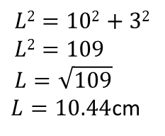
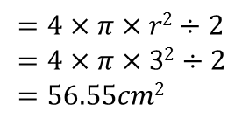
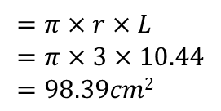
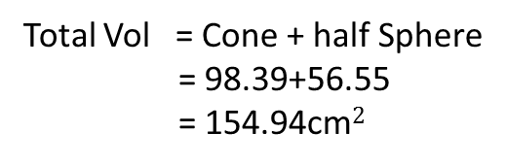
24
7
30
Date
Total Surface Area and Volume Composite Shapes
EQ – Describe how to find the Total Surface Area & Volume of different composite shapes.
How do we find the volume and TSA of 3 dimensional shapes? This time for a cone or pyramid and a sphere.
Find the Volume of this shape and again we need to paint it so you will also need to find the total surface area as well?
Pythagoras
$$L2=102+32 \\ L2=109 \\ L=\sqrt{109}$$ $L=10.44$cm
L
SA – find the Total Surface Area.
SA of cone
$$=π×r×L \\ =π×3×10.44 \\ =98.39cm2$$
$$Volume of Rt pyramid or cone \\ =\frac{1}{3}Area of Base×ht \\ Volume of Sphere \\ =\frac{4}{3}×πr3$$
SA of ½ Sphere
$$=4×π×r2÷2 \\ =4×π×32÷2 \\ =56.55cm2$$
Total Vol = Cone + half Sphere
= 98.39+56.55
= 154.94cm$2$

Slide 6
24
7
30
Date
Total Surface Area and Volume Composite Shapes
EQ – Describe how to find the Total Surface Area & Volume of different composite shapes.
How do we find the volume and TSA of 3 dimensional shapes? This time for a cone or pyramid and a sphere.
Do exercise 3.5 and 3.6 page 38 & 39 Dwyer book
$$Volume of Rt pyramid or cone \\ =\frac{1}{3}Area of Base×ht \\ Volume of Sphere \\ =\frac{4}{3}×πr3$$

Slide 7
Notes Review
24, 7 ,30
Date
Title
Essential question
Notes complete
Notes complete with colour and diagrams
Questions completed
Contents page filed in
Formula page filled in

Slide 8
Homework
Review your notes and write a summary answering the essential question.

